Slide 1


Unit 1 A Greener Future
Southeast University

Slide 2
Teaching Objectives
To learn the concept of “low-carbon lifestyle”;
To know how to live a more environmentally friendly lifestyle;
To talk and write about green life;
To have a good command of the key language points
To plan a team project;

Slide 3
Warming up
Initializing the project
Exploring the field
Constructing the project
Assessing learning

Slide 4
1. List as many words as possible about environmental problems and tell others what you know about them.
d______ f____ sandstorm
______ storm _____ rain d____________
________ weather t________
___________ effect _______ warming
rising __________ melting of _______
extinction of ________ ecological _________
rought
lood
snow
acid
eforestation
extreme
yphoon
greenhouse
global
sea level
glacier
species
imbalance

Slide 5
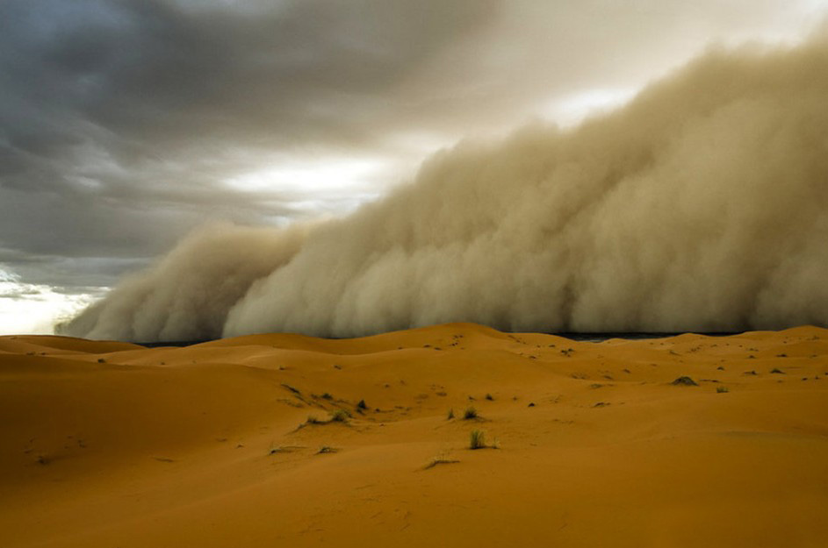
2. Picture description: Look at the following pictures and describe the causes and effects of these natural disasters to your partner with the help of tips.
Tips: breathing difficulty, traffic jams,
communication failure, horrible view ...
Reference

Slide 6
Reference:
The sandstorm is a horrible phenomenon. The clouds of dust are so heavy that you can hardly breathe. It is so dark that it may cause traffic accidents.

Slide 7
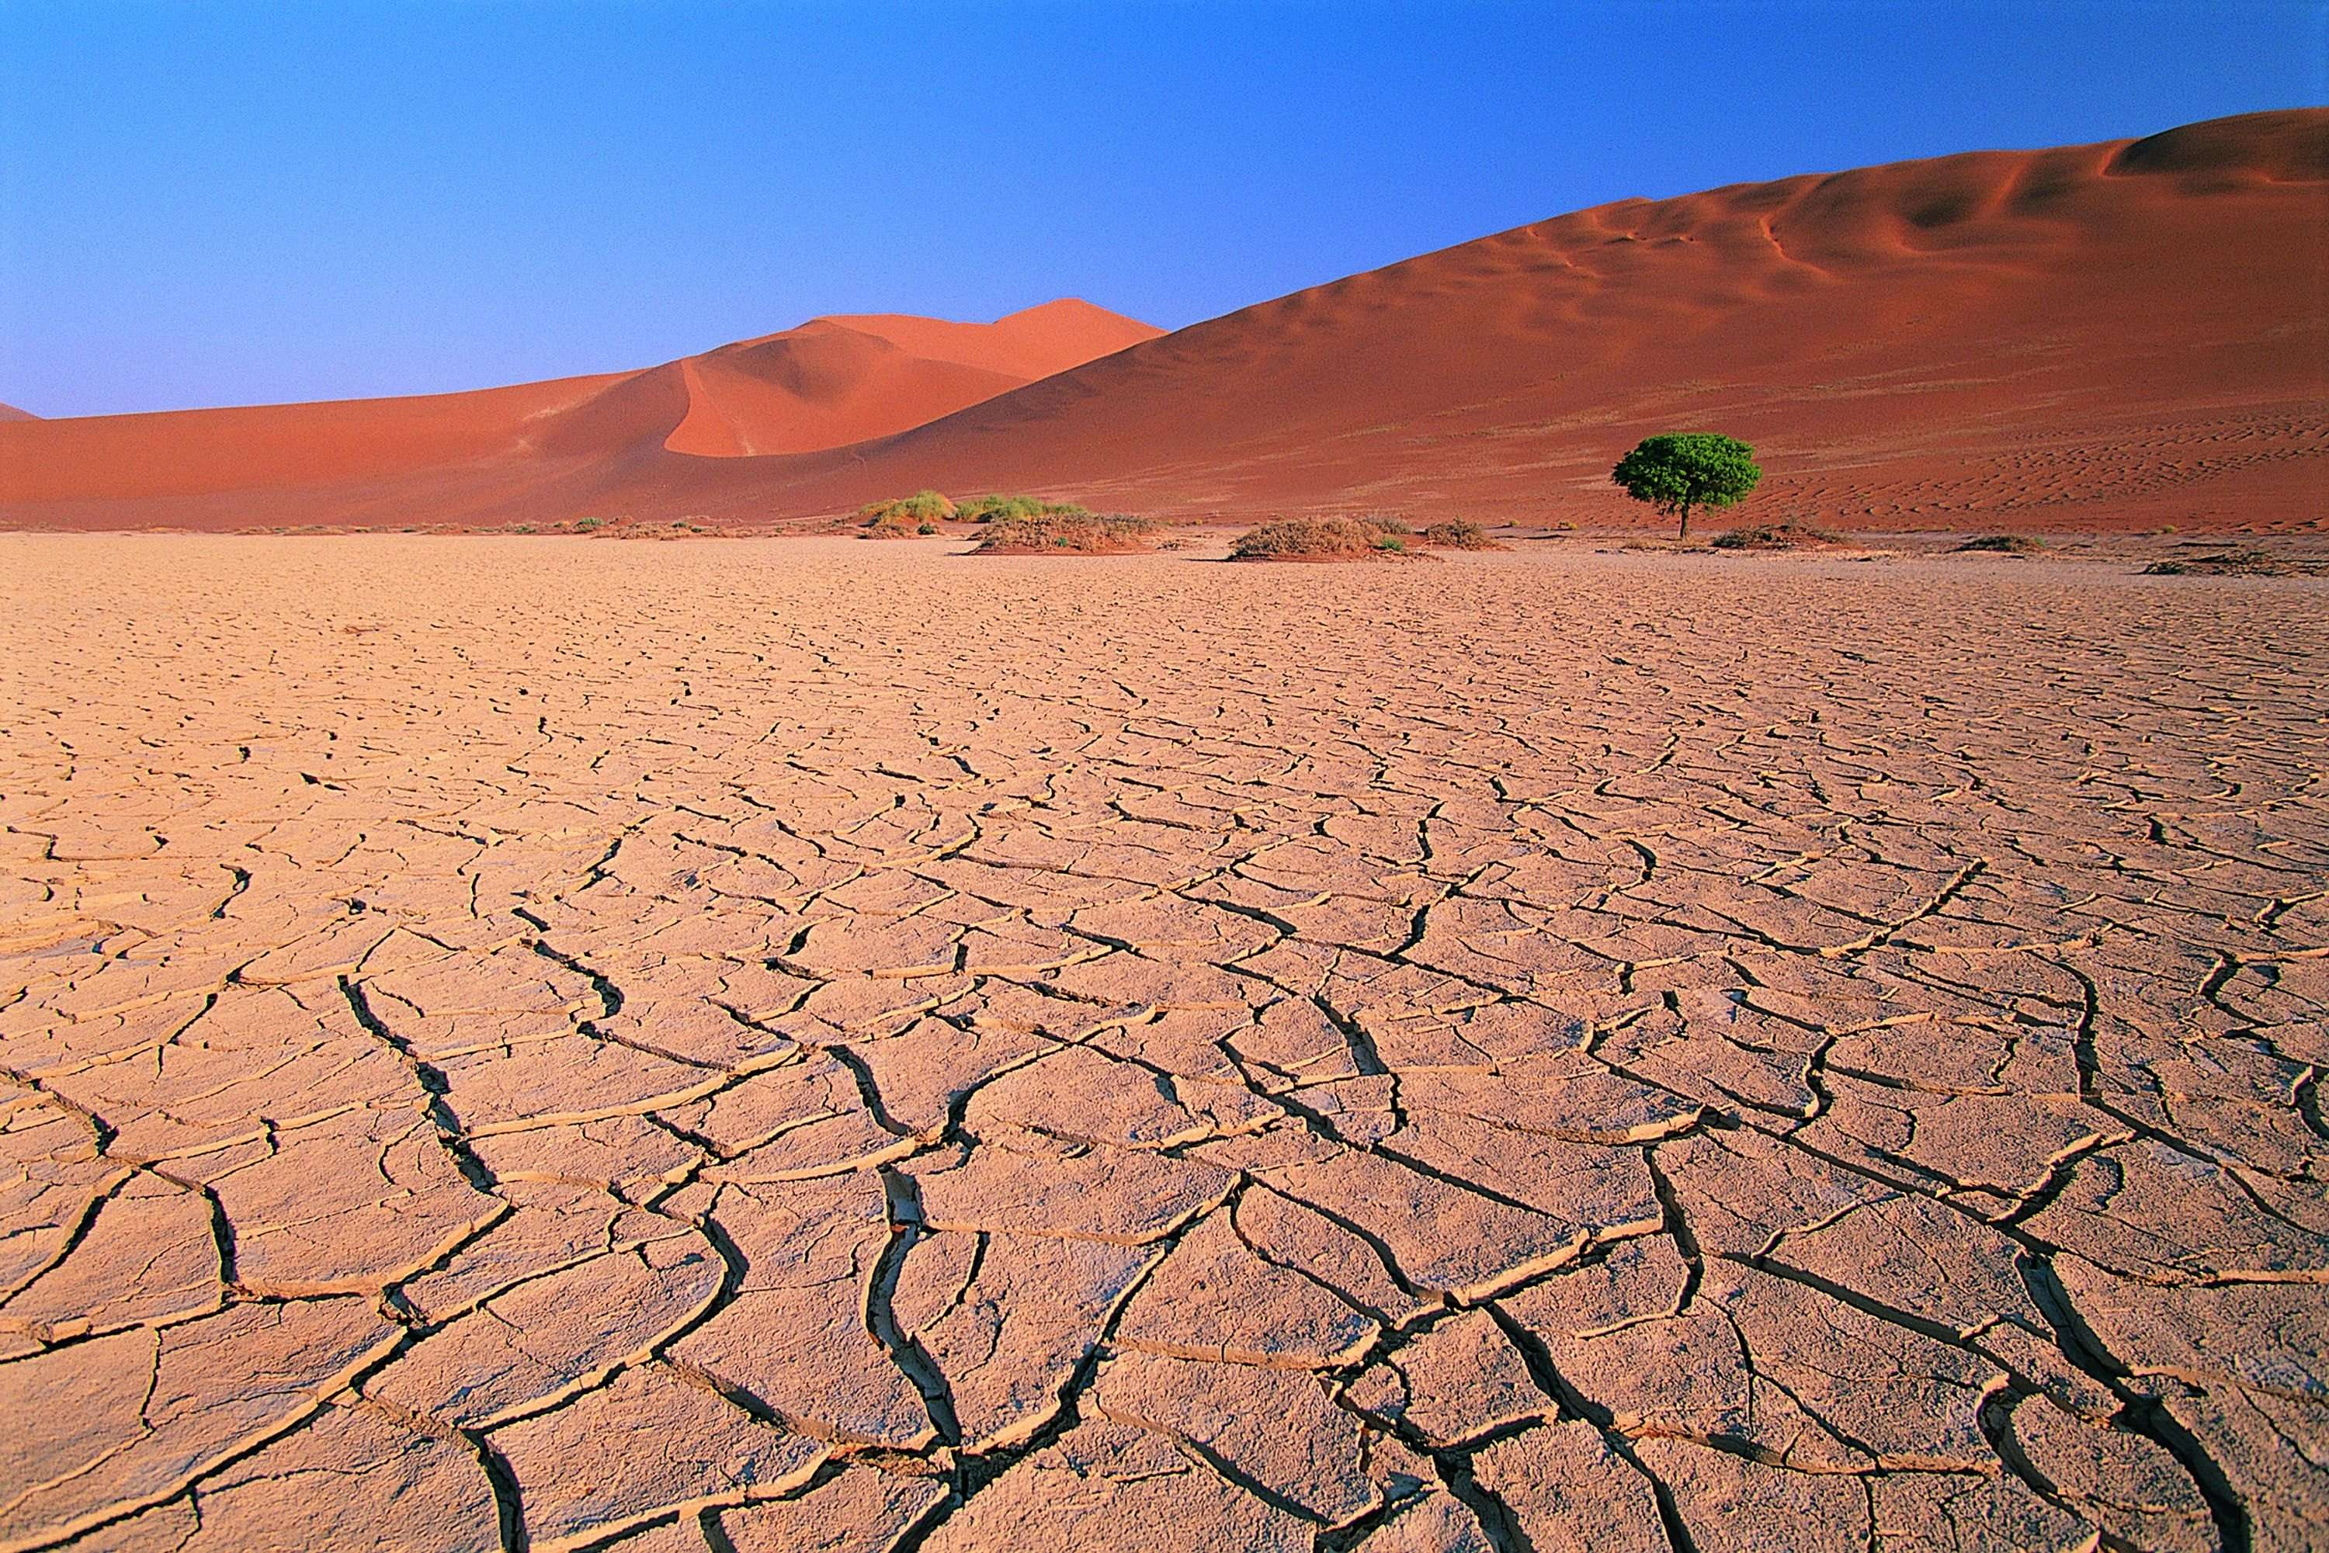
Tips:
crops losses, food / water shortages ...
Reference

Slide 8
Reference:
Droughts result from lack of water, which is essential for plants and animals. The failure of crops leads to food shortage, and sometimes even famine.

Slide 9
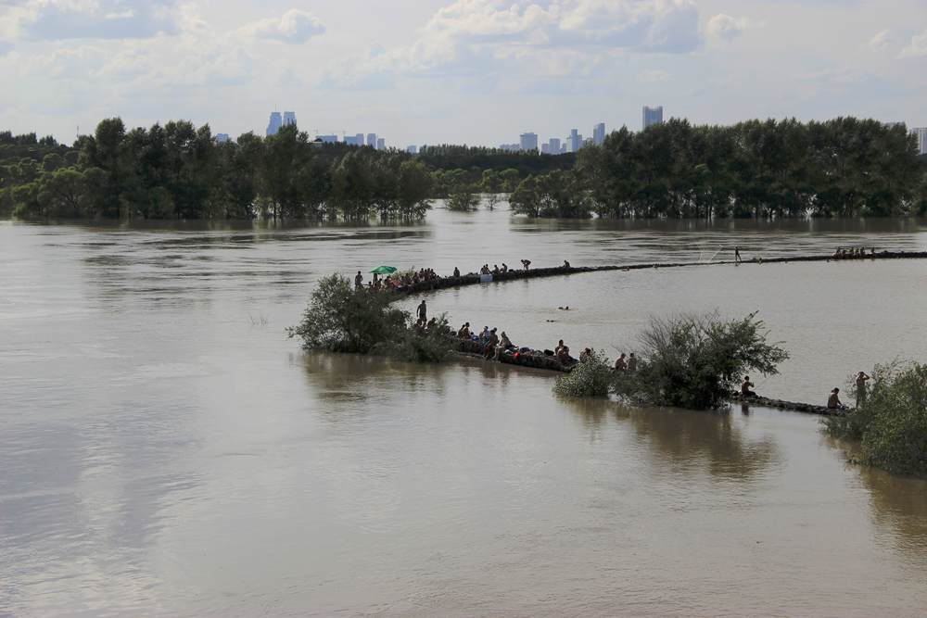
Tips:
life and property losses, homeless, diseases ...
Reference

Slide 10
Reference:
The flood washes away houses, destroys fields, and causes life and property losses. People may be left homeless and suffer diseases.

Slide 11
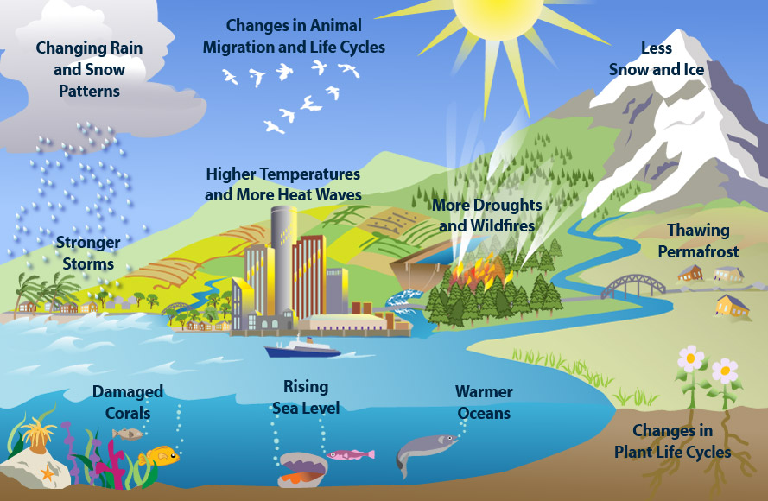
Tips:
increase in earth's temperature, human activities, changes in rainfall patterns, a rise in sea level, impacts on plants, wildlife, and humans…
Reference

Slide 12
Reference:
Global warming is a mix of rising temperatures on our planet, it results from the burning of fossil fuels, which may hasten species extinction, influence the length of seasons, cause coastal flooding, and lead to more frequent and severe storms

Slide 13
3. Background information
1) Watch the video clip Earth Day before class and think about the following questions.
a. What is Earth Day?
b. Why was the 1st Earth Day organized?
c. What do you think of the idea of giving up the one-day-a-year celebration of Earth Day and making every day Earth Day?

Slide 14
2) Go to the library or surf the internet to familiarize you with following items: carbon footprint, zero waste, RecycleMania, Energy Star, the Dust Bowl

Slide 15

Carbon Footprint
Do you know “carbon footprint”
(碳足迹)？
It is the total amount of CO2 and other greenhouse gases (GHG) emitted over the full life cycle of a product or service.

Slide 16

Then what is your carbon footprint?
Your carbon footprint is the total amount of greenhouse gases produced by human activities. It is measured in units of carbon dioxide.

Slide 17
Zero Waste
Zero waste is a philosophy that encourages the redesign of resource life cycles so that all products are reused. No trash is sent to landfills and incinerators. The process recommended is one similar to the way that resources are reused in nature.
Zero Waste is a goal that is ethical, economical, efficient and visionary, to guide people in changing their lifestyles and practices to emulate sustainable natural cycles, where all discarded materials are designed to become resources for others to use. Zero Waste means designing and managing products and processes to systematically avoid and eliminate the volume and toxicity of waste and materials, conserve and recover all resources, and not burn or bury them. Implementing Zero Waste will eliminate all discharges to land, water or air that are a threat to planetary, human, animal or plant health.

Slide 18
RecycleMania
RecycleMania is a friendly competition and benchmarking tool for college and university recycling programs to promote waste reduction activities to their campus communities. Over an 8-week period each spring, colleges across the United States and Canada report the amount of recycling and trash collected each week and are in turn ranked in various categories based on who recycles the most on a per capita basis, as well as which schools have the best recycling rate as a percentage of total waste and which schools generate the least amount of combined trash and recycling.

Slide 19
With each week’s updated ranking, participating schools follow their performance against other colleges and use the results to rally their campus to reduce and recycle more.
To read more about the 2013 Tournament results, visit www.recyclemaniacs.org.
National recognition is provided to the winning school in each category on the RecycleMania website and in a national press release. Winning schools receive an award made out of recyclable materials, and win the right to host that category’s special traveling trophy for the coming year.

Slide 20
Energy Star
Energy Star is a program that was first developed in 1992 by the U.S. Environmental Protection Agency (EPA) as a method to identify and promote products that are energy efficient.
Products carrying this symbol provide a way for businesses and consumers to save money, while at the same time, protect our environment. Since its initial onset, the government has partnered with other industry members, to promote and expand the scope of this project to include, not only major appliances, but also new homes and buildings.

Slide 21
The Dust Bowl
It got its name after Black Sunday, April 14, 1935. More and more dust storms had been blowing up in the years leading up to that day. In 1932, 14 dust storms were recorded on the Plains. In 1933, there were 38 storms. By 1934, it was estimated that 100 million acres of farmland had lost all or most of the topsoil to the winds. By April 1935, there had been weeks of dust storms, but the cloud that appeared on the horizon that Sunday was the worst. Winds were clocked at 60 mph. Then it hit.

Slide 22
1. Pair work:
How green you are (P7 Activity 1)
Work with your partner on the table on Page 7 to see if you are living a green life. When you've done with the table, reflect on your life, make a summary about how green your life is.

Slide 23
A quiz-- How green you are?
When you leave a room, do you turn off electrical appliances and lights? (often, sometimes, never)
Do you minimize the use of air conditioning and heating?
Do you buy things more than you need at Taobao?
Do you purchase items made from recycled materials?
Do you select products with longer shelf life?
Do you double print the paper?
Do you look for ENERGY STAR logo when buying computers?

Slide 24
2. Video Time:
Low Carbon Life (P10-11)
Watch the video and do Activity 1&2 on Page 10 &11.

Slide 25

1. What is the purpose of the special series
“My Low-carbon Life”?
________________________________________
________________________________________
2. Why does Lin Hui always select products
with longer shelf life when he shops?
________________________________________
________________________________________
3. How does Lin Hui think of a low-carbon lifestyle?
_________________________________________
What does the booklet produced by WWF offer
to the general public?
__________________________________________
What is the prospect of low-carbon lifestyles?
___________________________________________________________________________________
To raise people’s awareness of energy conservation and carbon reduction.
Because he thinks this can not only reduce waste and also help reduce CO₂.
It’s a personal mission that will never end.
It offers guidance for a low-carbon lifestyle.
Only certain groups of people might choose to live a low-carbon life.
Key
Clear

Slide 26

Activity 2
Watch the video clip again. Try to fill in the table with the information from the video clip.
Key
Clear
 | Lin Hui | Li Lin
Workplace | Works for an 1) ______________ ____________________ set up by him and his friends Information provided in the website: 2) ______________________________________________________ | Works for the WWF, one of the world’s leading 3) ____________ _____________________ Guidance offered in the WWF booklet: 4)_________________ _________________________ ______________________________________________________
Low-carbon Life | 5)______________________ 6)_____________________________________________________ | 7)_________________________ 8)__________________________ 9)__________________________
environmental website
conservation organizations
carbon offset, environment policies, tips on how to save energy, etc.
30 ways to save energy, why to save, what to eat, how to travel, and how to calculate savings
Checking expire dates
Taking public transportation to work
Try not to use paper cups, or select the smaller ones
Uses energy saving lights
Double print the paper
Notes:
Double print the paper

Slide 27
1. Global Reading of Passage A
1) Scan the text for the first time and do Activity 1 on Page 15.
2) Read the text for the second time and do Activity 2 on Page 15.
3) Assign Activity 3 to students to do after class.

Slide 28
Scan the passage and locate the answers to the following questions. Put the number of the paragraph in the brackets and write your answers below.
Activity 1
Key
Clear
(Para.__ ) 1. Why did Cornell president say “Sustainability is no longer an elective”?
__________________________________________________________________________________________________________________________________________
(Para.__ ) 2. What does the fact that Kalamazoo College won the 2008 champion of RecycleMania competition indicate?
__________________________________________________________________________________________________________________________________________
(Para.__ ) 3. What are the typical features of a green building? _________________
___________________________________________________________________
(Para.__ ) 4. According to the passage, what effort are many universities making to help students become environmentally friendly?
____________________________________________________________________
(Para.__ ) 5. What’s the ultimate goal of students’ taking courses and doing research projects on the environment?
____________________________________________________________________
a
By saying “Sustainability is no longer an elective”, Cornell President implies that students have taken great initiative in earth-protecting movement.
b
Kalamazoo College’s winning of the 2008 champion of Recycle Mania Competition indicates that recycling has been widely spread among college students.
c
A green building features
geothermal heating, organic gardens, bamboo flooring and Energy Star appliances.
d
They offer courses and scholarships to encourage students to study the environment.
e
To put into practice what they have learned in courses and research projects.

Slide 29
The first paragraph of the passage is an introduction to the whole passage. This introductory paragraph suggests that the structure of the passage will fall into three main sections:
1. Zero-waste buildings on campuses;
2. Competitions waged among students to boost recycling;
3. Courses, majors and scholarships for the study of environment.
Activity 2
Work in pairs. Read the rest of the passage carefully, try to identify how the different parts of the passage relate to each of the headings in the following table. Does the text follow the structure suggested in the first paragraph? Discuss your answers with your partner.

Slide 30
The content of the passage is organized in the way of “general to specific”, i.e. the author first introduces the nationwide RecycleMania competition among colleges (Para.2), followed by the introduction of green buildings (Para. 3) and a variety of courses, research projects and scholarships (Paras. 4&5) at several universities. In the last paragraph the author illustrates the popularity of environmentalism among college students by citing one specific example of Maggie Stonecash and her fellow students. The structure of the passage is as follows:
Section | Paragraph(s)
Introduction
Zero-waste buildings on campuses
Competitions among colleges
Courses, majors and scholarships
A case of sustainable farming
Para.1
Para.2
Para.3
Para.4 Para5
Para.6
Key
Clear

Slide 31
2. Detailed Reading of Passage A
Vocabulary and expressions, difficult sentences.

Slide 32

Green, Greener, Greenest
By Anne Underwood and Daniel Stone

Slide 33
1. Environmentalism is taking serious root on campuses. You can see it across the nation, from the zero-waste stadium at the University of California, Davis, to a $ 10,000 gift of solar panels to Vassar from the class of 2007. Students have gotten into the spirit, waging competitions to boost recycling and slash energy use in dorms. There are courses and entire majors built around environmental issues. There are even a few scholarships. The newfound attention makes senses. Higher education is well positioned to shape not only eco-aware citizens; but green engineers, architects and policymakers. Cornell president David Skorton puts it best: “Sustainability is no longer an elective.”

Slide 34
2. For evidence of how the movement has spread, consider the nationwide RecycleMania competition among colleges. The 2008 champion wasn’t a powerhouse university like Harvard or Stanford with an established reputation for environmentalism. It was tiny Kalamazoo College in Michigan. During the 10-week contest, K’zoo students recycled 59 percent of their trash. (Harvard and Standford totaled 27 percent and 30 percent, respectively.) Members of the recycling club launched a “dorm storm”, ambushing students in their rooms and preaching the virtues of waste reduction. They collected recyclables from public bins around campus---even carting Styrofoam and old computers to companies that could reprocess them. They cut discarded books from binding so the paper could be recycled. Even old chairs, mugs, speaker systems ---and a piano ---found new life at the campus exchange, a room full of secondhand stuff that’s free.

Slide 35
3. Green buildings are also cropping up on campuses, from Duke with its green-roofed “Smart Home” (a dorm that also functions as a laboratory for green living) to the new University of California, Merced, where all the buildings meet the exacting standards of the U.S. Green Building Council. One of the most unusual projects is at Furman University in Greenville, S.C. In June 2008, the college opened a solar-powered showcase home called Cliffs Cottage in conjunction with Southern Living magazine. At 3,400 square feet, it could be an environmentalist’s trophy home. It features geothermal heating, organic gardens, bamboo flooring (since bamboo is quick-growing) and ENERGY STAR appliances. The house generates 6 to 10 times more energy than it uses, thanks to solar panels outside and energy-sparing technologies within. For a year, Cliffs Cottage will be open to the public. After that, it will become Furman’s Center for Sustainability, with classes on green living.

Slide 36
4. For those seeking more-rigorous ways to study the environment there is no lack of options. Colorado State University offers more than 100 courses in fields from engineering to atmospheric science. “Students can work with professors who are engaged in the latest ideas on reducing climate change and producing new energy sources,” says CSU president Larry Edward Penley. Several years ago, engineering students came up with a way to retrofit two-stroke engines on snowmobiles, making for cleaner, more efficient machines. A company called Envirofit International is now marketing the technology in Asia to help cut pollution from auto rickshaws. Students will also be able to help with multiple research

Slide 37
5. It’s not just the sciences that offer opportunities for study. Dickinson College in Carlisle, Pennsylvania, has more than 70 classes in departments like policy studies and history. “Humans have transformed the environment, and the environment has affected human events,” says environmental historian Jeremy Vetter. He points to the Dust Bowl of the 1930s, when severe dust storms devastated so much farmland that the government stepped in to help save topsoil. Furman has even added a core-curriculum requirement for environmental studies, with classes like The Sustainable Corporation and Environmental Writing. And the college offers scholarships of up to $7,500 a year to environmentally active students.

Slide 38
6. Ultimately, the goal for many students will be to translate their experiences into internships and jobs. For Maggie Stonecash, a 2008 Dickinson graduate, that means spending six months helping to manage the college’s 15-acre organic farm. She and her fellow interns take field trips to places like the Rodale Institute, which is a leader in sustainable farming, and to nearby farms that raise grass-fed beef or use “no till” practices to spare the topsoil. They live on the farm for “full immersion” (and they live in yurts---large, round Mongolian-style tents, which are solar-powered and off the grid). “I feel passionate about organic farming as a way to help bring back a sustainable lifestyle.” Stonecash says.

Slide 39
Difficult Sentences
Environmentalism is taking serious root on campuses. You can see it across the nation, from the zero-waste stadium at the University of California, Davis, to a $ 10,000 gift of solar panels to Vassar from the class of 2007.
(Line1-3，Para1）
环保主义思想已经深深地扎根于校园。从加利福尼亚大学戴维斯分校的“零浪费”运动场到纽约州瓦瑟学院2007级学生献给学校的价值10 000美元的太阳能电池板，你可以看到环保运动已经蔓延到了全国。

Slide 40
2. Higher education is well positioned to shape not only eco-aware citizens; but green engineers, architects and policymakers. Cornell president David Skorton puts it best: “Sustainability is no longer an elective.”
(Line6-8, Para1)
高等教育明确定位，不仅要为社会培养有环保意识的公民，还要培养环保工程师、环保建筑师和环保政策的制定者。康奈尔大学的校长戴维·斯科顿说得好：“可持续发展势在必行。”

Slide 41
3. In June 2008, the college opened a solar-powered showcase home called Cliffs Cottage in conjunction with Southern Living magazine. At 3,400 square feet, it could be an environmentalist’s trophy home. It features geothermal heating, organic gardens, bamboo flooring (since bamboo is quick-growing) and ENERGY STAR appliances. (Line5-8,Para3)
2008年6月，福尔曼大学与《南方生活》杂志协力创建了名为“绝壁村舍”的太阳能展示区。它占地3 400平方英尺（315.9平方米），在将来也许会成为环保主义者的梦想住宅。其特点是拥有地热、有机花园、竹子地板（因为竹子长得快）和符合美国能源之星环保标准的设备。

Slide 42
4. Several years ago, engineering students came up with a way to retrofit two-stroke engines on snowmobiles, making for cleaner, more efficient machines. . A company called Envirofit International is now marketing the technology in Asia to help cut pollution from auto rickshaws. (Line5-7, Para4)
几年前，工程学专业的学生们就提出了改造雪上汽车中二冲程发动机的方法，此方法可以使汽车更环保，更节能。一家名为Envirofit国际集团的公司正在亚洲地区销售这种技术，以帮助减少机动人力车带来的污染。

Slide 43
5. He points to the Dust Bowl of the 1930s, when severe dust storms devastated so much farmland that the government stepped in to help save topsoil. (Line4-5,Para5)
他提到了20世纪30年代的沙尘暴时期，当恶劣的沙尘暴毁坏了大量的农田后，政府不得不介入表层土的保护问题。

Slide 44
6. She and her fellow interns take field trips to places like the Rodale Institute, which is a leader in sustainable farming, and to nearby farms that raise grass-fed beef or use “no till” practices to spare the topsoil.
她和同事们会开展实地考察旅行，到像罗德研究所那样的地方去参观，罗德研究所是可持续发展农场的典范。她们还去了附近的农场。那些农场饲养了完全食草的牛，并运用免耕技术来保护表层土壤。

Slide 45
New words and Phrases
Para1:
environmentalism: 环保主义思想
the environment: the air, water, and land on Earth, which can be harmed by man's activities :
Eg. Some of these chemicals are very damaging to the environment.
legislation to protect the environment
the effects of acid rain on the environment
the government minister for the environment

Slide 46
working/learning environment
Eg. a pleasant working environment
political/economic environment
Eg. a stable economic environment
good for the environment:
people who want to protect the environment:
things that cause harm to the environment :
environmentally friendly , eco-friendly, sustainable,
recyclable, biodegradable, renewable, organic
greens, eco-warriors
pollution, greenhouse gases, global warming, acid rain, deforestation

Slide 47
2. waste:
核废料 ——
放射性废料——
有毒废料——
废品——
废纸——
废物处理——
nuclear waste
radioactive waste
toxic waste
waste product
waste paper
waste disposal
industrial waste
工业废料 ——
化学废料 ——
家庭废料 ——
chemical waste
household waste
be a waste of---
(money/time/ effort/space)

Slide 48
3. wage: to be involved in a war against someone, or a fight against something实行，进行
Eg. wage war (on somebody/something)
The police are waging war on drug pushers (毒贩)in the city.
wage a campaign/struggle/battle etc
Eg. The council has waged a vigorous campaign against the proposal.

Slide 49
4. boost: 1. to increase or improve something and make it more successful :促进，提高
Eg.The new resort area has boosted tourism.
boost somebody’s confidence/morale/ego
增强/提高信心 /士气/自尊心
The win boosted the team's confidence.
2. also boost up to help someone reach a higher place by lifting or pushing them:帮助，提升
eg. He boosted her up. 他帮助她树立起了信心。
3. if a rocket or motor boosts a spacecraft, it makes it go up into space or go in a particular direction 推动

Slide 50
5. slash: 1) to cut or try to cut something violently with a knife, sword etc: 挥砍； 鞭打
eg. Someone had slashed the tires.
2) to greatly reduce an amount, price etc - used especially in newspapers and advertising [= cut]: 大幅削减
Eg.The workforce has been slashed by 50%.
slash your wrists: to cut the veins in your wrists with the intention of killing yourself (Guess the meaning?)

Slide 51
Para2
1.powerhouse: n. 1) organization or place where there is a lot of activity or where a lot of things are produced 强大的集团[组织]
Europe's industrial powerhouse
2) someone who is very strong or has a lot of energy :
精力充沛的人，身强力壮的人
2. respectively 分别地;各自地
Their sons, Ben and Jonathan, were three and six respectively.他们的儿子，本和乔纳森，分别是3岁和6岁。
3. ambush: If a group of people ambush their enemies, they attack them after hiding and waiting for them.打埋伏,伏击

Slide 52
4. preach: 1) When people preach a belief or a course of action, they try to persuade other people to accept the belief or to take the course of action.宣传；鼓吹
现在健康专家都在宣扬，即使是少量的运动也远比根本不运动好得多。
2) If you say that someone practices what they preach, you mean that they behave in the way that they encourage other people to behave in. 以身作则；身体力行
He ought to practice what he preaches. 他应该以身作则。
3) 布道，讲道
5. reprocess: 再生，再加工,再利用
We can reprocess the cardboard boxes.
Health experts are now preaching that even a little exercise is far better than none at all.

Slide 53
Para3
1. crop up: 1) if a problem crops up, it happens or appears suddenly and in an unexpected way [= arise] 突然出现
2) if something such as a name or a subject crops up, it appears in something you read or hear [= come up]:
Your name kept cropping up in conversation.

Slide 54
2. exacting: demanding a lot of effort, careful work, or skill [= demanding]: 严厉的，严格的
She was an exacting woman to work for.
exacting standards/demands/requirements etc
He could never live up to his father‘s exacting standards. 他从未达到他父亲的严格标准。

Slide 55
Para4
1. retrofit: (past tense and past participle) retrofitted, (present participle ) retrofitting [transitive]:to improve a machine, piece of equipment, building etc by putting new and better parts in it after it has been used for some time:对（机器）更新部件;对（建筑物）进行翻新
受损的房子已经修好，公路重铺了，大楼也翻新了。
Damaged houses have been repaired, roads repaved and buildings retrofitted.
2. two-stroke: 两冲程的（发动机）

Slide 56
Useful Expressions
1. 生根；扎根 take root
2. 太阳能电池板 solar panels
3. 领略---的精神 get into the spirit
4. 开展竞赛活动 wage competitions
5. 环境问题 environmental issues
6. 有意义 make sense
7. 被定位为 be positioned to
8. 有环保意识的公民 eco-aware citizens
9. 环保工程师 green engineers
10. 可持续发展势在必行 sustainability is no longer an elective

Slide 57
Useful Expressions
11. 著名学府 a powerhouse university
12. 宣传减少浪费的美德 preach the virtues of waste reduction
13. 突然出现 crop up
14. 绿色生活 green living
15. 太阳能展示区 a solar-powered showcase home
16. 连同，与---协力 in conjunction with
17. 地热 geothermal heating
18. 能源节约技术 energy-sparing technologies
19. 不乏--- there is no lack of
20. 从事，参加 be engaged in
21. 提出；想出 come up with

Slide 58
.
Useful Expressions
22. 促成；造就 make for
23. 介入；插手干预 step in
24. 热衷于环保工作的学生 environmentally active students
25. 把---应用到--- translate ---into
26. 开展实地考察旅行 take field trips
27. 可持续耕种 sustainable farming
28. 饲养完全食草的牛 raise grass-fed beef
29. 没有电网 off the grid
30 对---充满激情 feel passionate about

Slide 59
3. Developing critical thinking ability
Group work:
1)Read Passage A critically and discuss the following questions with your group members.

Slide 60
a. In what way do you think the courses on environmental issues help raise students’eco-awareness?
b. Do you think green buildings mean green living? Why or why not?
c. “Humans have transformed the environment, and the environment has affected human events.”What is your comment on this quotation?
d. Could you suggest some courses on environmental studies for your university?
e. What do you think should be the ultimate goal of environmentalism on university campuses?

Slide 61
2) Watch the video clip My Green School Dream before class, think about the following questions and report your comments on the idea of building green schools to your group members in the class.
a. Why does the speaker say the school is extremely green?
b. What are the rules that people should follow if they want to build similar green community?
c. Do you think it practical to build such a green school in China? Why or why not?

Slide 62
4. Global Reading of Passage B
1) Skim the text for the first time and answer the questions on Page 3 on Coursebook.

Slide 63
2) Read the text for the second time and fill in the blanks.
Purpose: ______________________________________
Thesis: ________________________________________
_________________________________
Supporting details:
a. ___________________________________________
b. ____________________________________________
c. ___________________________________________
d. ___________________________________________
To raise people’s awareness of protecting nature
Rapid climate change may accelerate hunger, poverty and even social unrest.
Rapid climate change will threaten economic development.
Climate change will worsen food security.
Environmental stresses are likely to heighten social tensions.
A case in point: the world’s tropical rainforests.

Slide 64
5. Detailed Reading of Passage B
Vocabulary and expressions, difficult sentences.

Slide 65
Green Alert
As the world edged into financial crisis, there were repeated warnings that we were headed for disaster. In the end, disaster struck. In many ways, the challenge of climate change has a similar feel, and the alarm bells are ringing just as loudly. But while it was possible to bail out the banks and to stimulate economic recovery with trillions of dollars of public finance, it will not be possible to bail out the climate—unless we act now.

Slide 66
Yet even when the basic science of climate change has been accepted by almost all scientists, many others still seem to think that it is unfounded, and that the world has more important questions to address. Reducing poverty, increasing food production, combating terrorism, and sustaining economic recovery are seen as more deserving of our attention. But this is a false choice, for climate change is not an alternative priority to all of these; it is in fact a "risk multiplier," a factor that will undermine our ability to achieve any of these things.

Slide 67
For example, ending poverty so that every person has the opportunity to lead a good life is already a hugely challenging ambition, and rapid climate change will make it more so. Several studies have set out how climatic change will threaten economic development, especially in the most vulnerable and poorest countries. This will, in turn, damage programs to reduce poverty.

Slide 68
Food security is already at risk because of soil erosion and the volatility of oil and gas prices that sustain industrial farming, while demand is rising because of population growth and changing diets. Climate change will exacerbate this squeeze. According to a United Nations Environment Program projection, agricultural productivity could drop by up to 50 percent in many developing countries by 2080—not least because of changed patterns of rainfall.

Slide 69
These environmental stresses are likely to heighten social tensions. If in the future it becomes clear that the world‘s big polluters knew but did little or nothing about these problems, a whole new generation of resentment might be born.
With this in mind, it seems to me that we need to adopt a new approach. Surely the starting point must be to see the world as it really is, and perhaps to accept that the economy is a wholly owned subsidiary of Nature and not the other way around. Nature is, after all, the capital that underpins capitalism. The world's tropical rainforests provide a powerful case in point.

Slide 70
These incredible ecosystems harbor more than half the earth's terrestrial biodiversity, on which, whether we like it or not, human survival depends. They generate rainfall; they are home to many of the world's indigenous peoples; and they help meet the needs of hundreds of millions of other people. They also hold vast quantities of carbon. But they are being cleared and burned at a rate of about 6 million hectares per year. In addition to hastening a mass extinction of species—many of which could hold the answer to the treatment of human diseases as well as the key to new technologies based on mimicking Nature's genius—this is causing massive greenhouse-gas emissions, accounting for about a fifth of the total.

Slide 71
This is precisely why my Rainforests Project has expended so much effort during these last two years to help facilitate a consensus on increasing international cooperation to cut deforestation. Back in April, I was able to host a meeting of world leaders at St. James's Palace in London, in the margins of the G20 summit, where it was agreed to establish a new informal working group to look at how rates of deforestation could be slowed as rapidly as possible. The group came back with recommendations just a few weeks ago, and it is enormously heartening to see the degree of partnership that has developed between countries, environmental groups, and companies that are determined to work together toward implementing the proposals for dealing with the underlying economic root causes of deforestation.

Slide 72
Through providing countries with financial rewards for their positive performance in cutting deforestation (or for not starting it in the first place), we would make it possible for rainforest nations to implement strategies for sustainable development more quickly and without having to rely so heavily on the kind of economic activities that cause deforestation. By using—in addition to public-sector finance—innovative, long-term investment instruments, perhaps facilitated by the multilateral development banks, we could restore vast areas of already degraded land to increase food output. At the same time, money would be available for new health and education programs, as well as genuinely integrated rural-development models. In return, the world would sustain the vital ecosystem services upon which we all rely for our economic, physical, and spiritual survival.

Slide 73
Difficult sentences
1. Reducing poverty, increasing food production, combating terrorism, and sustaining economic recovery are seen as more deserving of our attention. But this is a false choice, for climate change is not an alternative priority to all of these; it is in fact a “risk multiplier,” a factor that will undermine our ability to achieve any of these things. （Line3, Para 2）
减少贫困，增加粮食产量，打击恐怖主义和复苏经济这些问题似乎更值得我们关注，但这却是个错误的选择，因为在气候变化的问题上，我们无从选择，它实际上是个“危机加速器”，一个能阻止我们能解决任何问题的关键因素。

Slide 74
2. Food security is already at risk because of soil erosion and the volatility of oil and gas prices that sustain industrial farming, while demand is rising because of population growth and changing diets. Climate change will exacerbate this squeeze. (Line1,Para4)
因为土壤侵蚀和油气价格的波动，粮食安全问题面临很多风险，因为油，气的价格支撑着整个工业化农业，而人口的增长和饮食结构的变化，导致人们对粮食的需求却日益增长。气候变化将恶化这一趋势。

Slide 75
3. These incredible ecosystems harbor more than half the Earth’s terrestrial biodiversity, on which, whether we like it or not, human survival depends. （Line1,Para.7）
Paraphrase: These unbelievable ecosystems shelter more than 50% biological diversities on the earth, which are essential for human beings to survive, whether we like it or not.
热带雨林神奇的生态系统维系着地球上超过半数的陆地生物。不管我们喜欢与否，他们都是人类赖以生存的基础。

Slide 76
4. In addition to hastening a mass extinction of species—many of which could hold the answer to the treatment of human diseases as well as the key to new technologies based on mimicking Nature's genius—this is causing massive greenhouse-gas emissions, accounting for about a fifth of the total. (Line5,Para7)
生态的破坏会加速大量物种的灭绝，其中一些物种是可以帮助或启发人类治愈疾病的，同时也是人类模仿自然基因科技发展的关键。除此以外，燃烧的同时还排放了占全球五分之一的温室气体。

Slide 77
5. ---it is enormously heartening to see the degree of partnership that has developed between countries, environmental groups, and companies that are determined to work together toward implementing the proposals for dealing with the underlying economic root causes of deforestation. (Line6,Para8)
Paraphrase: ……it is very encouraging to see the countries, environmental groups, and companies cooperate with each other to carry out the proposals ,which cope with the potential economic factors of deforestation.
看到各国之间，各环保组织之间和公司间的亲密合作，我们倍受鼓舞。他们为了履行一个提议而精诚合作，那就是处理森林砍伐表象下的深层经济原因。

Slide 78
6. By using—in addition to public-sector finance—innovative, long-term investment instruments, perhaps facilitated by the multilateral development banks, we could restore vast areas of already degraded land to increase food output. (Line4,Para9)
除了公共财政外，我们还可以运用新型的长效投资手段，或许那些多元化发展的银行能提供此方面的帮助，以此恢复那些已经被破坏的土地来增加粮食产量。

Slide 79
Words and Phrases
1. edge: to move gradually with several small movements, or to make something do this:
Tim was edging away from the crowd.
She edged closer to get a better look.
edge your way into/round/through etc something
Christine edged her way round the back of the house.
Christine 她慢慢走到后门.

Slide 80
2. strike: (疾病、灾难等)侵袭，爆发
eg: If something such as an illness or disaster strikes, it suddenly happens.
Bank of England officials continued to insist that the pound would soon return to stability but disaster struck.
英格兰银行官员仍然坚持说英镑不久就会恢复稳定，但结果灾难爆发了。

Slide 81
3. feel:摸上去;有…手感
eg: He remembered the feel of her skin...
他记得触摸她的皮肤的感觉。
Linen raincoats have a crisp, papery feel.
尼龙雨衣的手感又干又脆又薄，像纸一样。

Slide 82
4. bail out--- [American English]; bale out [British English] : 1) to escape from a situation that you do not want to be in any more:
eg. After ten years in the business, McArthur is baling out. 做了10年生意， McArthur再也不想继续下去了。
2) bail somebody/something out
also bale somebody/something out [British English] to do something to help someone out of trouble, especially financial problems: 帮助…脱离困境
Some local businesses have offered to bail out the museum. 当地的一些企业出资帮助博物馆走出了困境。
Sutton bailed his team out with a goal in the last minute.
3) to escape from a plane, using a parachute
The pilot bailed out safely. 飞行员安全地跳伞逃生

Slide 83
5. be deserving of --- to deserve something:
Eg. Some criminals are more deserving of their punishment than others.
6. alternative adj. 1) [only before noun] an alternative idea, plan etc is different from the one you have and can be used instead不同寻常的
alternative ways/approach/methods etc
alternative approaches to learning
Have you any alternative suggestions?
2) deliberately different from what is usual, expected, or traditional
非正统的，不寻常的，可替代的
alternative music/theatre etc 另类音乐/剧院，非正统音乐/剧院
sources of alternative energy (=energy produced by the sun, wind etc rather than by gas, coal etc) 替代能源
tolerance of alternative lifestyles 另类的生活方式的耐受性
alternative medicine/therapies (=medical treatment that is not based on the usual western methods) 另类疗法；替代疗法
Acupuncture is widely used by practitioners（从业者）of alternative medicine.

Slide 84
alternative n. [countable] something you can choose to do or use instead of something else
二中择一； 可供选择的事物
alternative to---
Is there a viable (切实可行的)alternative to the present system?
If payment is not received, legal action will be our only alternative. (唯一的选择)
I had no alternative but to report him to the police.
He quickly assessed what alternatives were open to him.

Slide 85
7. undermine: to gradually make someone or something less strong or effective 削弱，破坏
economic policies that threaten to undermine the health care system （医疗体制）
undermine somebody's confidence /authority /
Position / credibility etc
The constant criticism was beginning to undermine her confidence.

Slide 86
8. vulnerable: capable of being wounded or
hurt; 脆弱的;易受伤害的
eg: Old people are particularly vulnerable
members of our society.
老年人是社会中尤为明显的弱势群体。
n. vulnerability
eg: David accepts his own vulnerability.
戴维承认了自己的脆弱。

Slide 87
9. volatility: n. 挥发性； 挥发度
eg: He is keen to see a general reduction in arms sales given the volatility of the
region.
鉴于该地区局势动荡，他非常希望武器销
售能全面缩减。

Slide 88
10. exacerbate: vt. 使恶化； 使加重； 激怒
eg: Remedial action is always expensive and, in some cases, may actually exacerbate the
problem.
补救工作总是代价很大，并且在某些时候反
而会使问题更严重。

Slide 89
11. not least: used to emphasize that something is important: 尤其，特别是
Eg. My mother was upset about his appearance here, not least because she felt it was invading her privacy.
12. heighten : if something heightens a feeling, effect etc, or if a feeling etc heightens, it becomes stronger or increases
[= intensify; strengthen]:
There are fears that the march will heighten racial tension.
Increased levels of fat in the diet could heighten the risk of cancer.加强---
heighten (somebody's) awareness (of something)(=make people realize something more clearly)提高---
The case has heightened public awareness of the problem of sexual harassment. (性骚扰)

Slide 90
13. subsidiary:子公司,附属品
eg: He entered a subsidiary of the well-known
company.
他进入这家著名公司的子公司。
a subsidiary of a US company
one of our Japanese subsidiaries

Slide 91
14. a case in point 佐证，恰当的例子； 明证
eg: A case in point is your reversal of the
formerly deteriorating relationship with France.
这方面的一个例子就是你扭转了过去同法
国恶化的关系。
Any other phrase with “case?”
in this/that case, in some/ many/ most cases, in any case, in no case, in case of sth, in the case of sth, in case ---,
be on somebody's case: (informal) to be criticizing someone continuously :
Dad's always on my case about something or other.

Slide 92
15. underpin: vt. 用砖石结构等从下面支撑（墙等）； 加固（墙等）的基础； 加强…的基础
eg: Producers have, therefore, preferred term
sales contracts to underpin upfront investment. 生产商青睐长期销售合约，以保证前期投资。

Slide 93
16. harbor: vt.& vi. 心怀； 庇护； 避入安全地；
eg: They harbored refugees in times of war.
他们在战争期间收留难民。
He harbors a secret grudge against his father.
他对父亲暗怀不满。

Slide 94
17. biodiversity: n. 生物多类状态，生物多样性
eg: Great progress has been made in protection of biodiversity.
生物多样性保护取得重大进展。
Other words with “bio-”
biology，biochemistry, biotechnology(生物工艺学)，biography(传记), autobiography (自传)

Slide 95
18. indigenous: adj. 土生土长的； 生来的，固有的； 本地的； 根生土长
eg: Each country has its own indigenous cultural tradition.
每个国家都有其自身的文化传统。
Indians were the indigenous inhabitants of America. 印第安人是美洲的土著居民。

Slide 96
19. mimic: vt. 模仿，学样； 摹拟；
eg: In a mirage the desert will mimic a lake.
在海市蜃楼中，沙漠有时会现出湖泊的形
象。
He used to mimic speech peculiarities of
another.
他过去总是模仿别人讲话的特点。

Slide 97
20. facilitate: vt. 促进，助长； 使容易； 帮助
eg: The new trade agreement should facilitate more rapid economic growth.
新贸易协定应当会加快经济发展。
Both sides undertake to facilitate further
cultural exchanges.
双方承诺为进一步开展文化交流创造便利
条件。

Slide 98
21. account for: （在数量、比例上）占---， 解释
eg: These products, in total, account for about
80% of all our sales.
这些产品总共约占我们全部销售额的80％。
How can we account for the recent population explosion? 我们如何能解释最近人口激增的现象？
22. expend- expense 花费,耗尽
expand-expansion 扩展，扩张
Eg: Don‘t expend all your time、energy on such a useless job.
China will further expand the scope of its opened-up areas. 中国要进一步扩大开放范围。

Slide 99
23. consensus: an opinion that everyone in a group agrees with or accepts
consensus on/about---
a lack of consensus about the aims of the project
consensus that---
There is a consensus among teachers that children should have a broad understanding of the world.
The government failed to reach a consensus on the pace of integration(统一的步伐).
the current consensus of opinion
The general consensus was that technology was a good thing.
区别： consensus- census (人口调查)-consent n. 准许，赞同； 同意
If you give your consent to something, you give someone permission to do it.
content : n.内容； （书等的）目录； 满足； 容量
[kən’tent] adj.满足的，满意的；vt.使满足，使满意
I am content with what I have.= I content myself with what I have.
我满足于我所拥有的一切。

Slide 100
24. in the margins of a meeting 在---间隙
margin: 1）the empty space at the side of a page:空白处
Someone had scribbled a note in the margin.
2) the difference in the number of votes, points etc that exists between the winners and the losers of a competition or election 差额
by a wide/significant/narrowmargin很大的 /很小的比分差额
They're a world-class team and it was no surprise that they won by such a wide margin.
by a margin of 10 points/100 votes etc
The bill（法案） was approved by a margin of 55 votes.赞成票以55票优势领先。
on the margin(s)---a person on the margins of a situation or group has very little power, importance or influence [= on the fringes]:边缘
Unemployed youths are living on the margins of society.

Slide 101
25. implement: to take action or make changes that you have officially decided should happen实施，执行,落实---
implement a policy/plan/decision etc
We have decided to implement the committee‘s recommendations （提议）in full.
—implementation noun [uncountable]
the implementation of the peace plan

Slide 102
26. multilateral: adj. 多方面的，多边的； 多国的； 多国参加的
eg: The project is funded by the World Bank and other multilateral agencies.
这项计划由世界银行和其他多国机构资助。
Many want to abandon the multilateral trade
talks in Geneva.
很多国家想退出在日内瓦举行的多边贸易会谈。
Other words with multi-
multi-function, multi-media, multi-purpose, multi-mode, multitude, multiple, multiply (乘以，繁殖)

Slide 103
27. integrated adj. 完整的； 整体的； 结合的； （各组成部分）和谐的
eg: They soon became fully integrated into the local community. 他们很快就完全融入了当地人的圈子。
Immigrants are integrated into the community. 移民与该地区的居民融为一体。

Slide 104
6. Group discussion
Find information about the carbon footprints of the following countries (students collect information before class), discuss what roles governments should play in creating a greener future (what they have already done, what they are doing, what they should do...) and write a report of your discussion after class (one report from each group).

Slide 105
Country | Carbon Footprint | Roles to play
U.S.
India
Japan
Russia
China
Germany
Brazil
Sweden
Canada
Britain

Slide 106
Constructing the project
Based on what your learn from Unit 1 and work with your group members on the project Think Globally, Act Locally.

Slide 107
Your project should include the following items:
How green we are (individuals, campuses, countries...).
The consequences of current lifestyle and reasons for the existing problems.
How to be greener (individuals, campuses, governments, countries, the difficulties in achieving a greener future, the solutions to the problems...).

Slide 108
Assessing learning
Take a mini-exam about Unit 1 and write a composition.

Slide 109
Write a composition of 120-150 words based on the outlines given below:
On Environmental Protection
1. 目前环保还存在着许多问题。
2. 为了保护环境，政府做了大量的工作。
3. 我的看法。

Slide 110
sample
There are still many problems of environmental protection in recent years. One of the most serious problems is the serious pollution of air, water and soil. the polluted air does great harm to people's health. The polluted water causes diseases and death. What is more, vegetation had been greatly reduced with the rapid growth of modern cities.
To protect the environment, the government has done a lot. Legislative steps have been introduced to control air pollution, to protect the forest and sea resources and to stop any environmental pollution. Therefore, the government is playing the most important role in the environmental protection today.
In my opinion, to protect environment, the government must take even more concrete measures. First, it should let people fully realize the importance of environmental protection through education. Second, much more efforts should be made to put the population planning policy into practice, because more people mean more pollution. Finally, those who destroy the environment intentionally should be severely punished. We should let them know that destroying environment means destroying mankind themselves.

Slide 111


